Slide 1
Game Theory of Altruism vs. Selfishness
Problem : In what context can choosing group advantage win over individual advantage i.e. How can altruism be a viable strategy over selfishness?
(Prisoner’s Dilemma)

Slide 2

Solution
Created an evolving graph with “organisms”
Each Have:
Resources
Memory of past interactions
Vector of “family” organisms
Vector of “friend” organisms
Vector of “bad” organisms
Bad and friend list are based on past experience, family created with organism

Slide 3
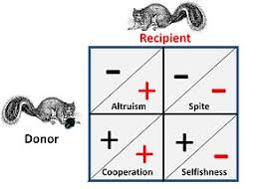
In one interaction
Each organism in a pair is given a choice(cooperate/ don’t cooperate)
If both cooperate
Each get 3 resources
If only one cooperates
Only the uncooperative one gets 5 resources
If neither cooperate
Each gets 1 resource
Organisms can employ different strategies for family, friends, bad organisms, and strangers based on organism type

Slide 4

During One Turn
For each round of the Turn:
- Each organism is paired off against another and chooses a
strategy
- resources are dealt based on the results
- The memory of the organisms is updated
- organisms can choose to put each other on the friend or bad
list

Slide 5
At the end of the Turn
Organisms with ten resources use these resources and create a duplicate “child” which employs the same strategy as the parent
When there get to be too many organisms, every other one is deleted
We can then track the frequency of different strategies over time

Slide 6

Rumors
Help Punish Selfish Organisms
Allows organisms to treat organisms as friends or bad organisms based on the experience of friends and family, rather than just personal experience
Employed by a breadth first traversal

Slide 7
Reading in Data
Organism files: contain info about different organism strategies:
Info about behavior towards:
Friends
Family
Bad organisms
strangers

Slide 8
Reading in Data (cont.)
Environment files contain info about:
How many organisms an organism can store as “friends”, “family”, and “bad” organisms
How far rumors can spread
The likelihood of an organism being paired with friends, family, or a random organism
How many organisms of each type there are initially

Slide 9

Different environments should produce different results

Slide 10

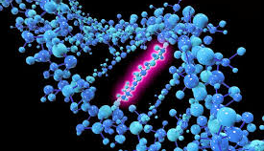

Where can I go from here?
Implement a system of feeding the program different environments and organism types automatically rather than randomly
Automatic analysis of which organisms are successful- store results
Create “mutations” where children organisms can vary from parents

